Slide 1


MENTORNESS PROJECT
DECODE GAMING BEHAVIOUR
BY AISWARYIA V

Slide 2
OBJECTIVE
The "Decoding Gaming Behavior" project aims to analyze and understand player behavior within a gaming dataset. By exploring various aspects of player interaction and performance, this project seeks to uncover insights that can inform game development, marketing strategies, and player engagement initiatives.
The dataset includes two tables: `Player Details` and `Level Details`.
In our analysis, we've crafted 15 queries aimed at uncovering key patterns and records within the data. These queries delve into various aspects of player behavior and performance, shedding light on important trends and metrics.

Slide 3

Dataset Description
Player Details Table:
`P_ID`: Player ID
`PName`: Player Name
`L1_status`: Level 1 Status
`L2_status`: Level 2 Status
`L1_code`: Systemgenerated Level 1 Code
`L2_code`: Systemgenerated Level 2 Code
Level Details Table:
`P_ID`: Player ID
`Dev_ID`: Device ID
`start_time`: Start Time
`stages_crossed`: Stages Crossed
`level`: Game Level
`difficulty`: Difficulty Level
`kill_count`: Kill Count
`headshots_count`: Headshots Count
`score`: Player Score
`lives_earned`: Extra Lives Earned

Slide 4
COLUMN NAME
There is a column named as ‘Unknown Column’ which does not make sense so I have changed the name of the column to Serial No .
QUERY
ALTER THE UNKNOWN COLUMN NAME
ALTER TABLE gameanalysis.player_details
CHANGE COLUMN MyUnknownColumn Serial_NO INT

Slide 5
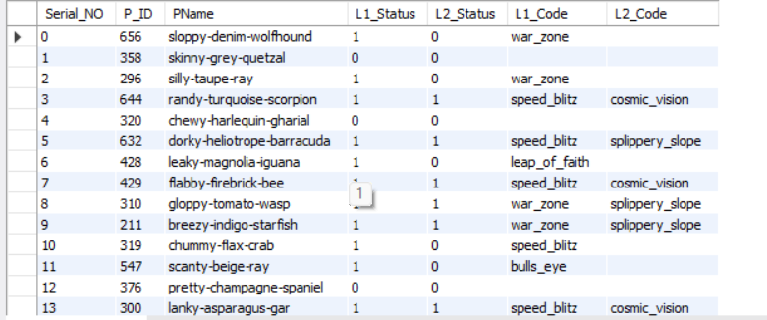
DISPLAY ALL THE RECORDS FROM BOTH THE TABLES
SELECT *
FROM gameanalysis.player_details
There are 30 rows present in player_details

Slide 6
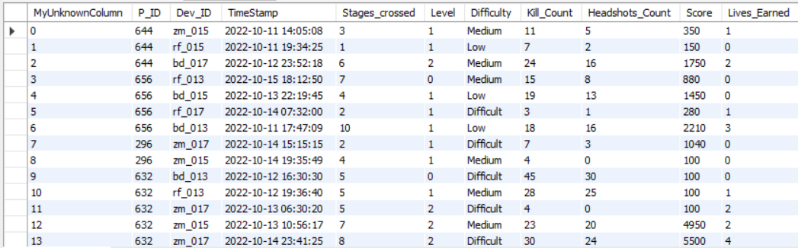
SELECT *
FROM gameanalysis.level_details2
There are 77 rows present in level_details

Slide 7
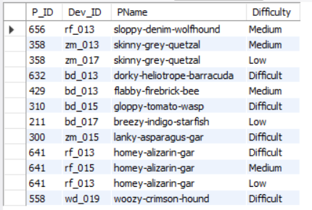
Extract `P_ID`, `Dev_ID`, `PName`, and `Difficulty_level` of all players at Level 0.
SELECT
ld.P_ID,
ld.Dev_ID,
pd.PName,
ld.Difficulty
FROM gameanalysis.player_details as pd
INNER JOIN gameanalysis.level_details2 as ld
ON pd.P_ID=ld.P_ID
WHERE Level =0

Slide 8

2. Find `Level1_code`wise average `Kill_Count` where `lives_earned` is 2, and at least 3 stages are crossed.
SELECT
pd.L1_code,
AVG(ld.Kill_Count) as avg_killcount
FROM gameanalysis.player_details as pd
JOIN gameanalysis.level_details2 as ld
ON pd.P_ID=ld.P_ID
WHERE ld.Lives_Earned=2 and ld.Stages_crossed>=3
GROUP BY pd.L1_code
ORDER BY pd.L1_code

Slide 9
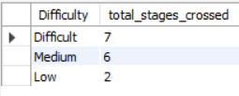
3. Find the total number of stages crossed at each difficulty level for Level 2 with players using `zm_series` devices. Arrange the result in decreasing order of the total number of stages crossed.
SELECT
Difficulty,
COUNT(Stages_crossed) as total_stages_crossed
FROM gameanalysis.level_details2
WHERE Level=2 AND Dev_ID like "zm_%“
GROUP BY Difficulty
ORDER BY total_stages_crossed DESC

Slide 10
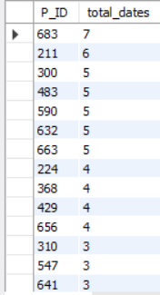
4. Extract `P_ID` and the total number of unique dates for those players who have played games on multiple days.
SELECT
P_ID,
COUNT(DISTINCT TimeStamp) AS total_dates
FROM gameanalysis.level_details2
GROUP BY P_ID
HAVING COUNT(DISTINCT TimeStamp) >1
ORDER BY total_dates DESC

Slide 11
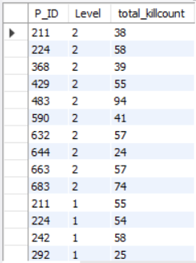
5. Find `P_ID` and levelwise sum of `kill_counts` where `kill_count` is greater than the average kill count for Medium difficulty.
SELECT
P_ID,
Level,
SUM(Kill_Count) AS total_killcount
FROM gameanalysis.level_details2
GROUP BY Level,P_ID
HAVING SUM(Kill_Count)>(SELECT AVG(Kill_Count) AS avg_killcount
FROM gameanalysis.level_details2
WHERE Difficulty='Medium’)
ORDER BY Level DESC

Slide 12
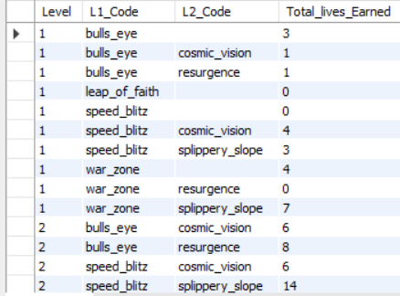
6. Find `Level` and its corresponding `Level_code`wise sum of lives earned, excluding Level 0. Arrange in ascending order of level.
SELECT
ld.Level,
pd.L1_Code,
pd.L2_Code ,
SUM(ld.Lives_Earned) AS Total_lives_Earned
FROM gameanalysis.player_details AS pd
JOIN gameanalysis.level_details2 AS ld
ON pd.P_ID=ld.P_ID
WHERE ld.Level!=0
GROUP BY ld.Level,pd.L1_Code,pd.L2_Code
ORDER BY ld.Level

Slide 13
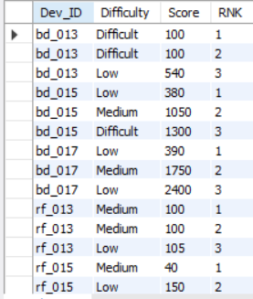
7. Find the top 3 scores based on each `Dev_ID` and rank them in increasing order using `Row_Number`. Display the difficulty as well.
WITH CTE AS
(
SELECT *,ROW_NUMBER() OVER(PARTITION BY Dev_ID ORDER BY Score ) AS RNK
FROM
gameanalysis.level_details2
)
SELECT
Dev_ID,
Difficulty,
Score,RNK
FROM CTE
WHERE RNK<=3
ORDER BY Dev_ID,RNK

Slide 14
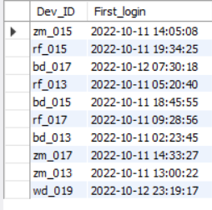
8. Find the `first_login` datetime for each device ID.
SELECT
Dev_ID,
MIN(TimeStamp) AS First_login
FROM gameanalysis.level_details2
GROUP BY Dev_ID

Slide 15
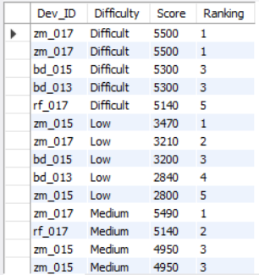
9.Find the top 5 scores based on each difficulty level and rank them in increasing order using `Rank`.Display `Dev_ID` as well.
WITH Ranks AS
(
SELECT
Dev_ID,
Difficulty,
Score,
RANK() OVER (PARTITION BY Difficulty ORDER BY Score DESC ) AS Ranking
FROM gameanalysis.level_details2
)
SELECT
Dev_ID,
Difficulty,
Score,
Ranking
FROM Ranks
WHERE Ranking<=5

Slide 16
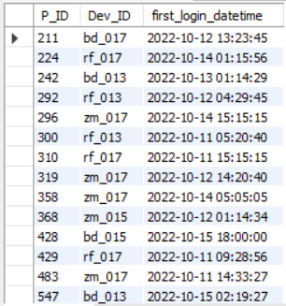
10. Find the device ID that is first logged in (based on `start_datetime`) for each player (`P_ID`). Output should contain player ID, device ID, and first login datetime.
WITH LoginDetails AS
(
SELECT
P_ID,
Dev_ID,
TimeStamp,
ROW_NUMBER() OVER(PARTITION BY P_ID ORDER BY TimeStamp ) AS Ranking
FROM gameanalysis.level_details2
)
SELECT
P_ID,
Dev_ID,
TimeStamp AS first_login_datetime
FROM LoginDetails
WHERE Ranking=1

Slide 17
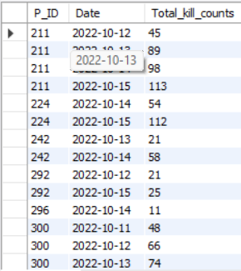
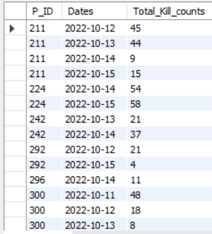
11. For each player and date, determine how many `kill_counts` were played by the player so far.
Using window functions
b) Without window functions
a)SELECT
DISTINCT P_ID,
DATE(TimeStamp) AS Date,
SUM(Kill_Count) OVER(PARTITION BY P_ID ,
DATE(TimeStamp)
ORDER BY DATE(TimeStamp) ) AS Total_kill_counts
FROM gameanalysis.level_details2
ORDER BY P_ID,Date
b)SELECT
P_ID,
DATE(TimeStamp) AS Dates,
SUM(Kill_Count) AS Total_Kill_counts
FROM gameanalysis.level_details2
GROUP BY P_ID,DATE(TimeStamp)
ORDER BY P_ID,Dates

Slide 18
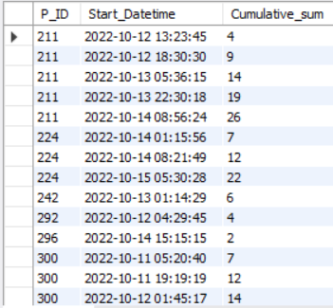
12. Find the cumulative sum of stages crossed over `start_datetime` for each `P_ID`, excluding the most recent `start_datetime`.
WITH STAGES AS
(
SELECT *,
ROW_NUMBER() OVER (PARTITION BY P_ID
ORDER BY TimeStamp DESC) AS Rnk
FROM gameanalysis.level_details2
)
SELECT
P_ID,
TimeStamp AS Start_Datetime,
SUM(Stages_crossed) OVER(PARTITION BY P_ID ORDER BY TimeStamp )
AS Cumulative_sum
FROM STAGES
WHERE Rnk!=1

Slide 19
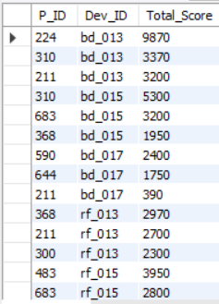
13. Extract the top 3 highest sums of scores for each `Dev_ID` and the corresponding `P_ID`.
WITH Scores AS
(
SELECT
P_ID,
Dev_ID,
SUM(Score) AS Total_Score,
RANK() OVER(PARTITION BY Dev_ID ORDER BY SUM(Score) DESC) AS Rnk
FROM gameanalysis.level_details2
GROUP BY P_ID,Dev_ID
)
SELECT
P_ID,
Dev_ID,
Total_Score
FROM Scores
WHERE Rnk<=3

Slide 20
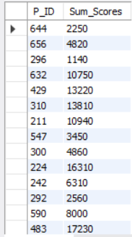
14. Find players who scored more than 50% of the average score, scored by the sum of
scores for each `P_ID`.
SELECT
P_ID,
SUM(Score) AS Sum_Scores
FROM gameanalysis.level_details2
GROUP BY P_ID
HAVING SUM(Score) > 0.5 *(SELECT AVG(Score)
FROM gameanalysis.level_details2
)

Slide 21
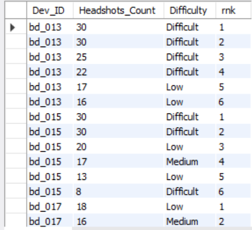
15. Create a stored procedure to find the top `n` `headshots_count` based on each `Dev_ID` and rank them in increasing order using `Row_Number`. Display the difficulty as well.
DELIMITER //
CREATE PROCEDURE top_headshots (IN n INT)
BEGIN
WITH Topheadshots AS
( SELECT ld.*,
ROW_NUMBER() OVER (PARTITION BY ld.Dev_ID ORDER BY ld.Headshots_Count DESC) AS rnk
FROM gameanalysis.level_details2 AS ld )
SELECT
Dev_ID,
Headshots_Count,
Difficulty,
rnk
FROM Topheadshots
WHERE
rnk <= n;
END//
DELIMITER ;
CALL top_headshots(6);

Slide 22
INSIGHTS
1. The average kill count varies significantly across different Level1 codes.
Some Level1 codes exhibit notably higher average kill counts compared to others, suggesting varying levels of difficulty or player engagement.
2.The zm_series device users demonstrate varied stage progression across different difficulty levels for Level 2.
While the majority of stages were crossed in the difficult level (7 stages), medium difficulty closely follows with 6 stages crossed, indicating a challenging gameplay experience for players.
3.Players exhibit a notable preference for higher difficulty levels, as evident by the higher total stages crossed in difficult and medium levels compared to low difficulty, highlighting their inclination towards more challenging gameplay experiences.
4.Players with multiple unique dates of gameplay exhibit higher levels of engagement and consistent participation in gaming sessions.

Slide 23
INSIGHTS
5.The total lives earned at each game level, also provide insights into player progression and engagement.By excluding Level 0, which likely represents the initial stages or tutorial, the analysis focused on player performance and achievement beyond the introductory phase.
6.The top 3 scores achieved by players using each device (Dev_ID), helps in recognizing high-performing players on various devices.By including the difficulty level along with the scores, the analysis offers insights into player achievements across different levels of gameplay.
7.Identifying the first login details for each player, helps in tracking player onboarding and initial engagement with the game.This information can be valuable for analyzing player retention, understanding device preferences, and optimizing the onboarding experience.
8.This analysis also helped us understand player progression over time, and also on historical gameplay patterns.
9.I have also identified the top-performing players (P_ID) on each device (Dev_ID) based on their total scores.P_ID 224 has scored the top score of 9870 on Dev_ID bd_013.

Slide 24
INSIGHTS
Potential Gameplay Insights:
There are gameplay details for 28 out of 29 players in the level_details2 table. So one player has no gameplays logged yet.
Out of 28 players with gameplay data, 20 have access to Level 1 based on L1_Status while 11 have access to Level 2 in the player_details table.
The number of stages crossed by players ranges from 1 to 10, with an average of ~5. So players are crossing about half the game on average per session logged.
Kill Count ranges from 2 to 50 per gameplay with top players like player ID 429 averaging 25 kills per gameplay. Lower skilled players average 10-15 kills. This shows a wide skill variation.
There are 7 unique device ids that are being used by the 28 active players. On average each device has gameplay logged for 4 different players.
The easiest levels seem to be the starter Level 0 while Level 2 has been tagged most frequently as "Difficult" - so the game progressively gets harder.
In summary, there is a good distribution of player skills, devices shared across players, they are able to progress through multiple stages on average and later levels seem to provide more challenge.
The insights suggest that game difficulty, stage progression, and availability of extra lives significantly influence player performance, particularly in terms of kill counts.
Game developers can leverage these findings to optimize game design, balance difficulty levels, and enhance player experience by adjusting stage progression and extra life .

Slide 25
THANK YOU

